Slide 1

movie Recommendation System
By – Ritika Ghanekar ,Nikita more and
Debjani Das

Slide 2
What is recommendation system?
Recommender systems are the systems that are designed to recommend things to the user based on many different factors. These systems predict the most likely product that the users are most likely to purchase and are of interest to. The recommender systems help their users to identify the correct product or movies for them.
Both the users and the services provided have benefited from these kinds of systems. The quality and decision-making process has also improved through these kinds of systems.

Slide 3
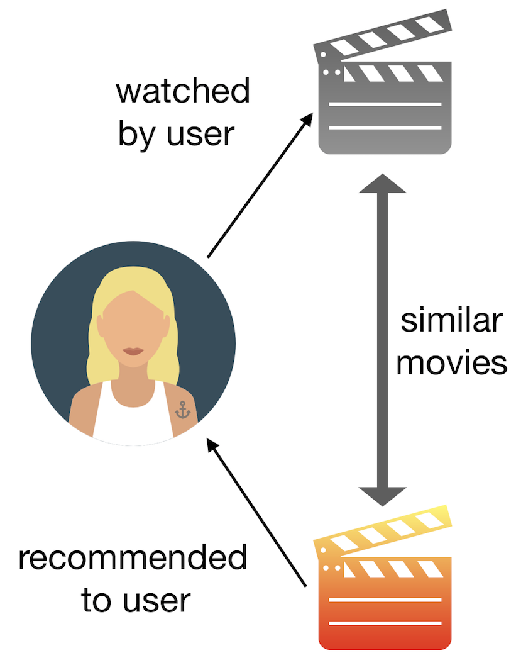
Content Based Recommendation
A content based recommender works with data that the user provides, either explicitly (rating) or implicitly (clicking on a link). Based on that data, a user profile is generated, which is then used to make suggestions to the user. As the user provides more inputs or takes actions on the recommendations, the engine becomes more and more accurate

Slide 4

How movies get filter ?
It is because Natural language processing (NLP)
Natural language processing (NLP) is an ability of a computer program to understand human language as it is spoken and written -- referred to as natural language.
there are 3 step :-

Slide 5
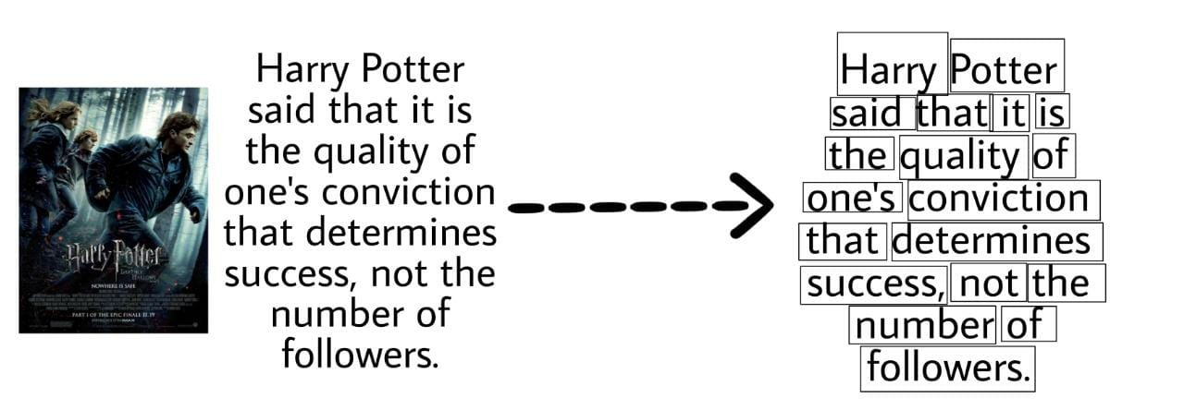
Tokenization
Tokenization is the process of breaking down sentence or paragraphs into smaller chunks of words called tokens.

Slide 6
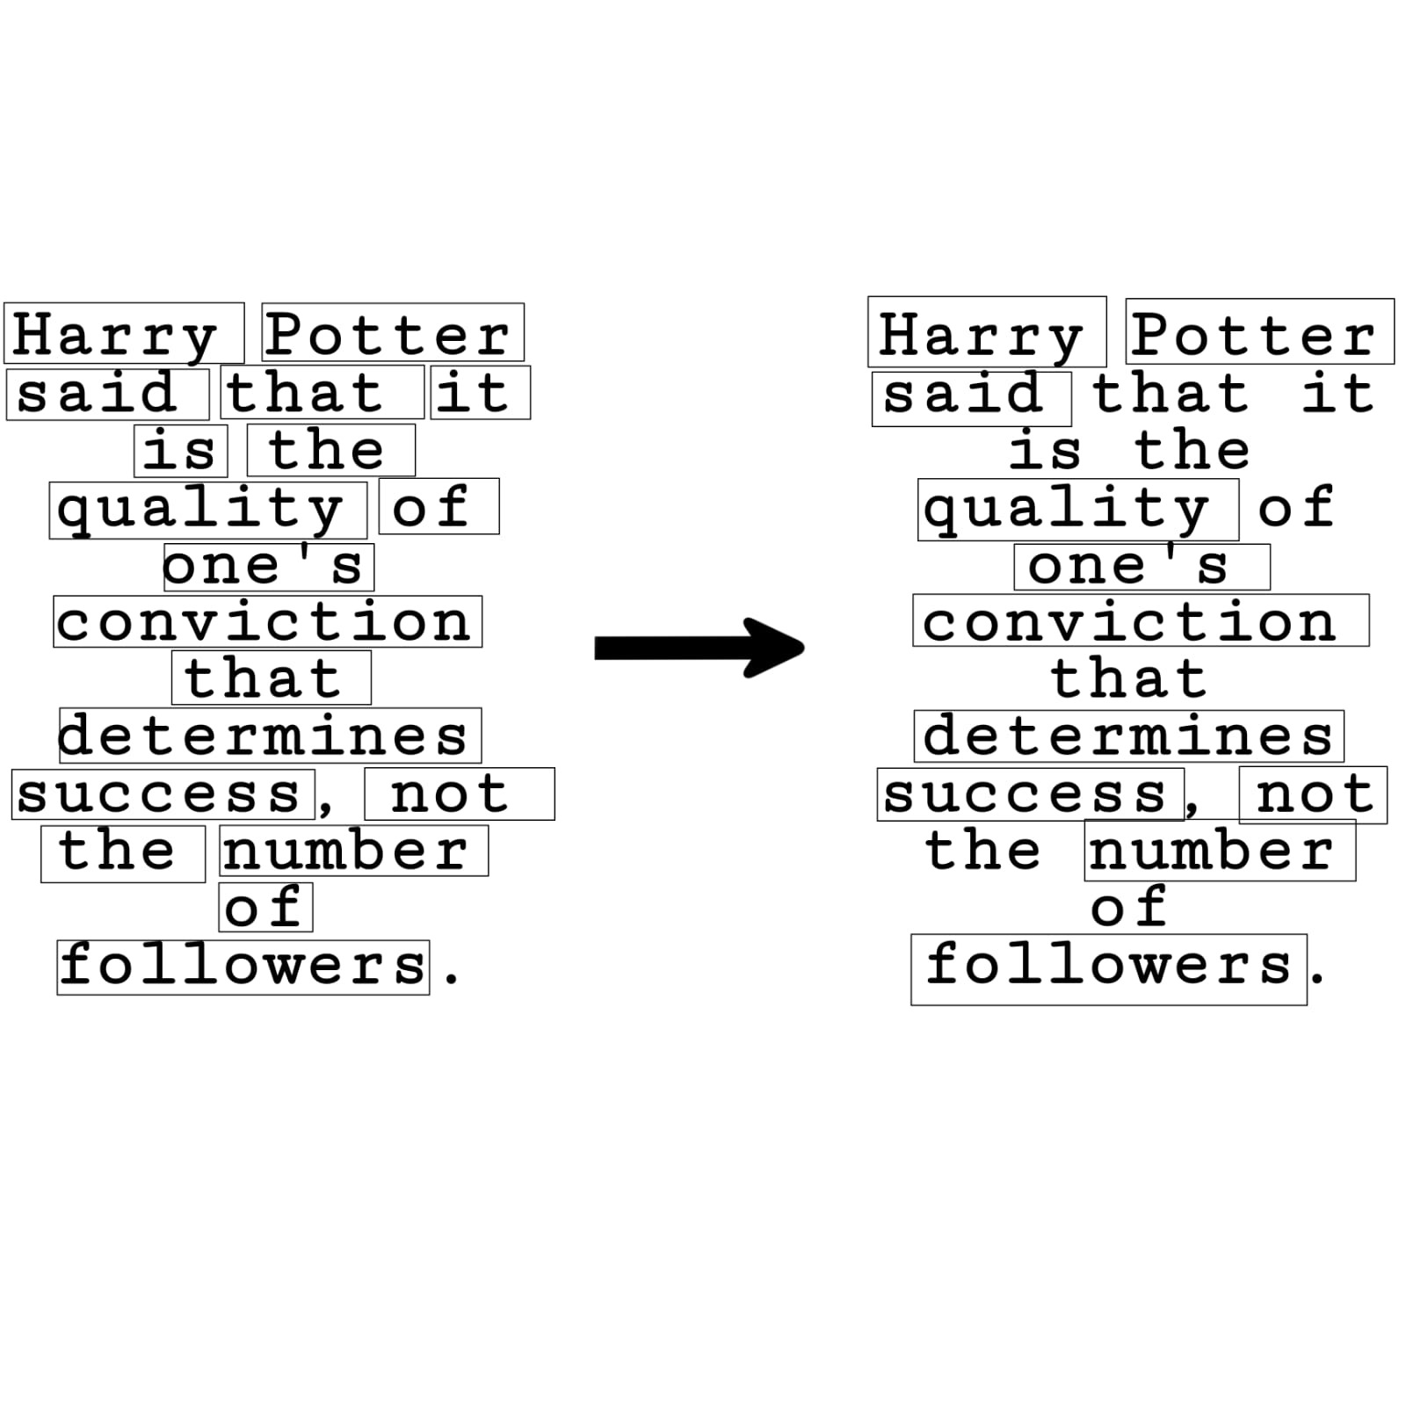
Stop Words Removal
On removal of some words, the meaning of the sentence doesn't change, like and, am. Those words are called stop-words and should be removed before feeding to any algorithm. In datasets, some non-stop words repeat very frequently. Those words too should be removed to get an unbiased result from the algorithm.

Slide 7
Vectorization
After tokenization, and stop words removal, our "content" are still in string format. We need to convert those strings to numbers based on their importance (features). We use TF-IDF vectorization to convert those text to vector of importance. With TF-IDF we can extract important words in our data. It assign rarely occurring words a high number, and frequently occurring words a very low number.

Slide 8
Steps for recommendation system
Gather the data
Data cleaning
Modelling
Testing the recommender

Slide 9
Combining all Data and concept we will go to implement the theory

